Slide 1
ALGEBRA 4
Day 55

Slide 2
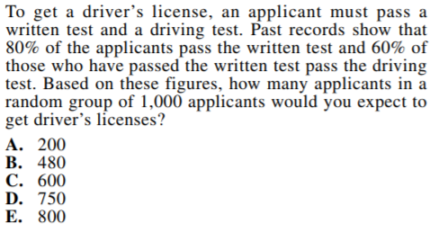
Bell Work

Slide 3
From Last Time
Page 685 #1-5, 7-9, 13-24, 29-33

Slide 4
11.2 Probability
Objective: To find the probability of an event using theoretical, experimental, and simulation methods
Probability: the likelihood an event will occur indicated by a number between 0 and 1
(Can be written as a fraction, decimal, or percentage)
1 = will always occur
0 = will never occur

Slide 5
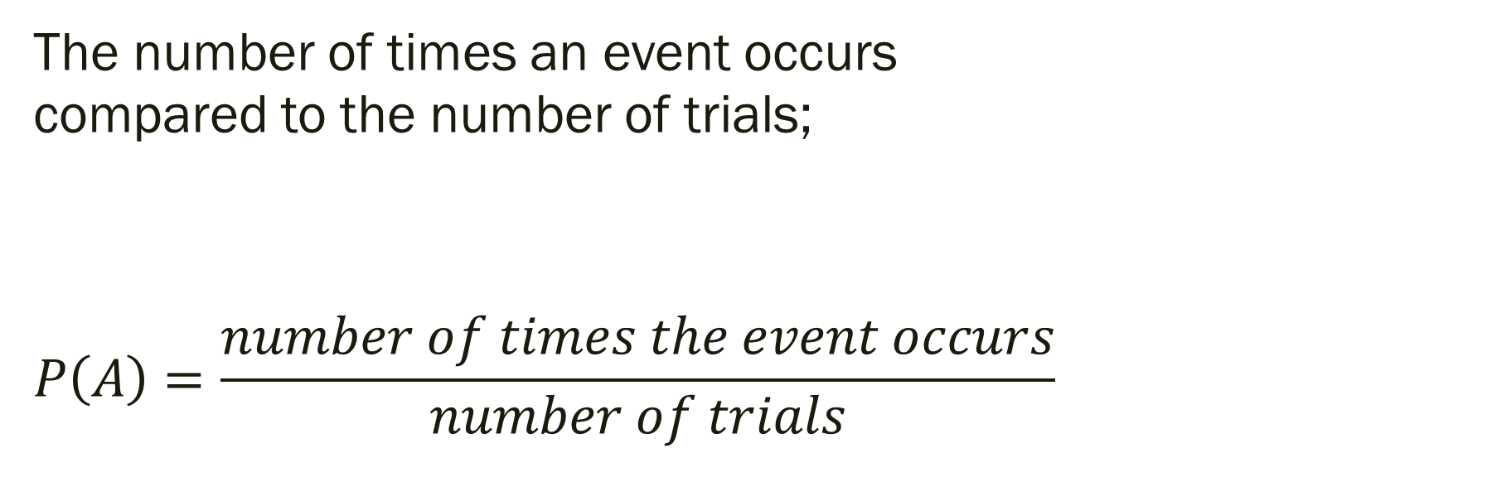
Experimental Probability:
The number of times an event occurs compared to the number of trials;
$$P\left(A\right)=\frac{number of times the event occurs}{number of trials}$$

Slide 6
Theoretical Probability:
The probability that an event will occur can be represented by;

Slide 7
Example: Experimental or Theoretical?
1.) Roll a die 30 times and record the amount of times each number shows up. What do you find? How does it compare to what you’d expect?
2.) You roll a six-sided die whose sides are numbered from 1 through 6. Find the probability of:
a.) Rolling a 4 b.) Rolling an odd number

Slide 8
Answer the following:
A jar contains 2 red marbles, 3 blue marbles, and 1 green marble. Find the probability of randomly drawing the given type of marble.
1) A red marble
2) A green marble
3) A yellow marble
4) A blue or a green marble
5) A red or a blue marble
6) A red or blue or green marble

Slide 9
Think Deeper…
You put a CD that has 8 songs in your CD player. You set the player to play the songs at random. The player plays all 8 songs without repeating any song.
1) What is the probability that the songs are played in the same order they are listed on the CD?
2) You have 4 favorite songs on the CD. What is the probability that 2 of your favorite songs are played first, in any order?

Slide 10
11.3 Probability of Multiple Events
Objective: To find the probability of event A and B.

Slide 11
Independent Events: if the occurrence of one event has NO effect on the occurrence of the other. (Ex: spinning a wheel, rolling a die, flip a coin, draw a marble with replacement)
Dependent Events: if the occurrence of one event AFFECTS the occurrence of the other. (Ex: Drawing marbles or cards without replacing)

Slide 12
Probability of A and B (Independent):
If A and B are independent events, then the probability that both A and B occur is:
P(A and B) = P(A) * P(B)
Probability of A and B (Dependent):
The probability that event B will occur given that A has already occurred:
P(A and B) = P(A) * P(B|A) ← prob of B given A

Slide 13
Mutually Exclusive Events: Event A and Event B share no intersection.
P(A and B) = 0
Probability of A or B:
If A and B are independent events, then the probability that both A and B occur is:
P(A or B) = P(A) + P(B) – P(A and B)

Slide 14
If event A is drawing a queen from a deck of cards and event B is drawing a king from the remaining cards, are the events A and B dependent or independent?
If event A is rolling a two on a six-sided die and event B is rolling a four on a different six-sided die, are the events A and B dependent or independent?

Slide 15
If event A is drawing a queen from a deck of cards and event B is drawing a king from the remaining cards, are the events A and B dependent or independent?
Dependent
If event A is rolling a two on a six-sided die and event B is rolling a four on a different six-sided die, are the events A and B dependent or independent?
Independent

Slide 16
Examples
Events A and B are independent. Find the indicated probability.
a) P(A) = 0.3 b) P(A) = ___
P(B) = 0.9 P(B) = 0.3
P(A and B) = ____ P(A and B) = 0.06

Slide 17
Examples
Events A and B are independent. Find the indicated probability.
a) P(A) = 0.3 b) P(A) = _.2__
P(B) = 0.9 P(B) = 0.3
P(A and B) = __.27__ P(A and B) = 0.06

Slide 18
A jar contains 12 red marbles, 16 blue marbles, and 18 white marbles.
a) Find the probability of choosing a red marble and then a white marble is chosen with replacement.
b) Three marbles are chosen from the jar with replacement. What is the probability that all are white?
c) Four marbles are chosen from the jar with replacement. What is the probability that none are blue?

Slide 19
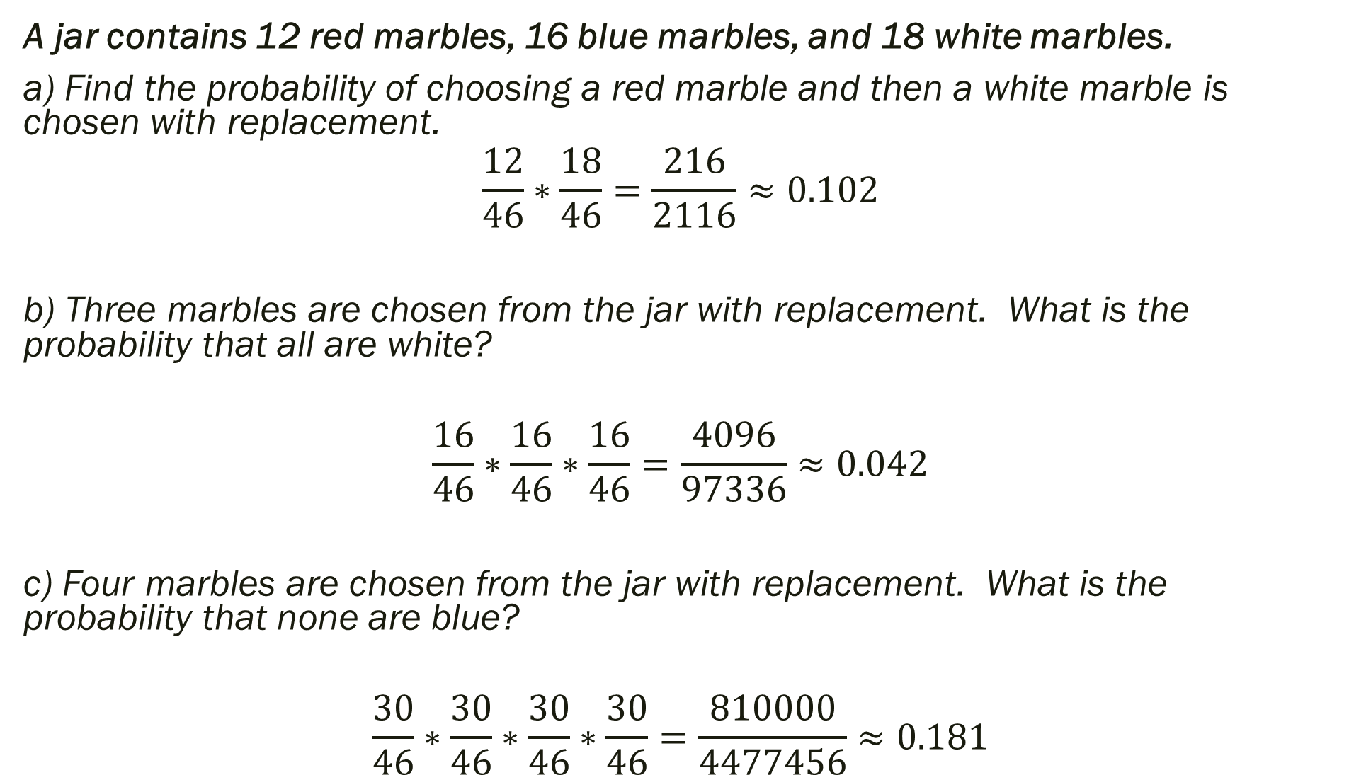
A jar contains 12 red marbles, 16 blue marbles, and 18 white marbles.
a) Find the probability of choosing a red marble and then a white marble is chosen with replacement.
$$\frac{12}{46}∗\frac{18}{46}=\frac{216}{2116}≈0.102$$
b) Three marbles are chosen from the jar with replacement. What is the probability that all are white?
$$\frac{16}{46}∗\frac{16}{46}∗\frac{16}{46}=\frac{4096}{97336}≈0.042$$
c) Four marbles are chosen from the jar with replacement. What is the probability that none are blue?
$$\frac{30}{46}∗\frac{30}{46}∗\frac{30}{46}∗\frac{30}{46}=\frac{810000}{4477456}≈0.181$$

Slide 20
In a survey of 200 pet owners, 103 owned dogs, 88 owned cats, 25 owned birds, 18 owned reptiles.
a) None of the respondents owned both a cat and a bird. What is the probability that they owned a cat or a bird?
b) Of the respondents, 52 owned both a cat and a dog. What is the probability that a respondent owned a cat or a dog?
c) Of the respondents, 119 owned a dog or a reptile. What is the probability that they owned a dog and a reptile?

Slide 21
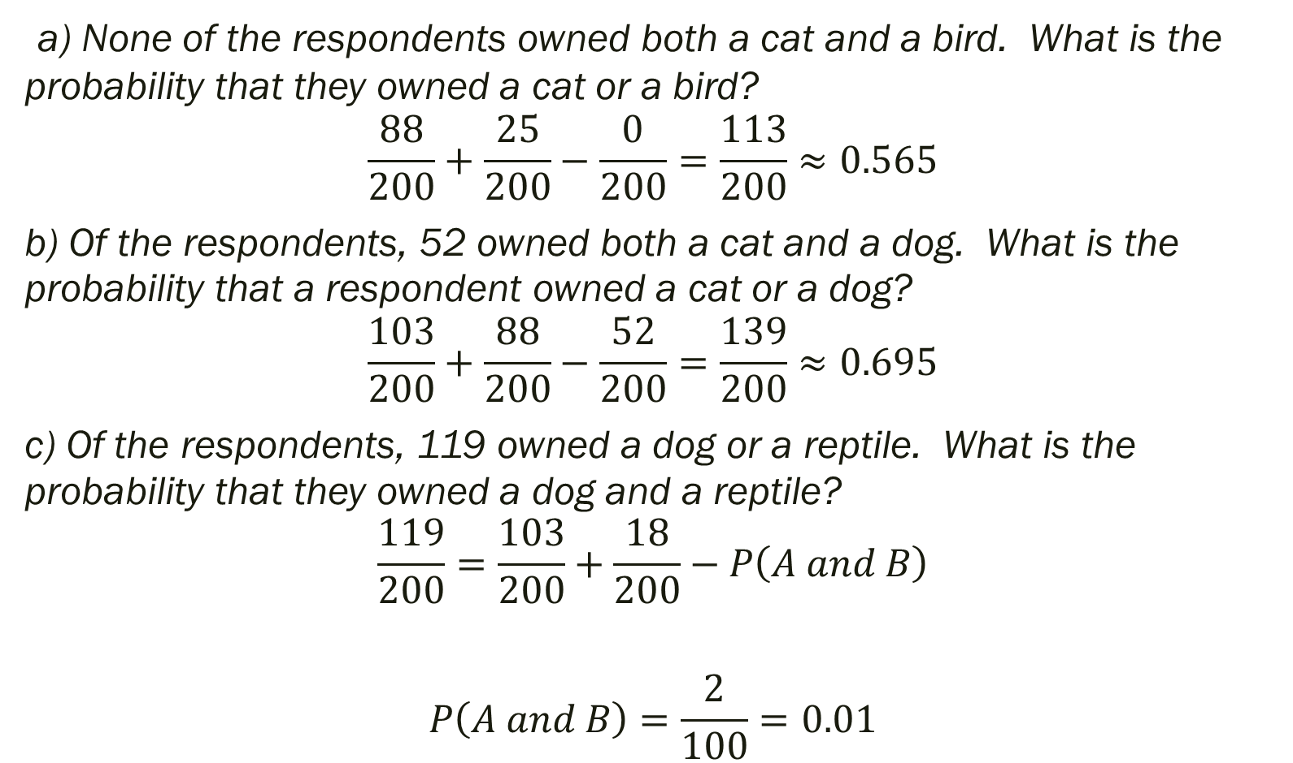
a) None of the respondents owned both a cat and a bird. What is the probability that they owned a cat or a bird?
$$\frac{88}{200}+\frac{25}{200}−\frac{0}{200}=\frac{113}{200}≈0.565$$
b) Of the respondents, 52 owned both a cat and a dog. What is the probability that a respondent owned a cat or a dog?
$$\frac{103}{200}+\frac{88}{200}−\frac{52}{200}=\frac{139}{200}≈0.695$$
c) Of the respondents, 119 owned a dog or a reptile. What is the probability that they owned a dog and a reptile?
$$\frac{119}{200}=\frac{103}{200}+\frac{18}{200}−P\left(A and B\right)$$
$$P\left(A and B\right)=\frac{2}{100}=0.01$$

Slide 22
For Next Time
page 691 #1-7, 9-12, 13-31 (odd)
Quiz Next Time

